Slide 1

FreedomWorks Center for Economic Freedom
The Budget Policy and Grassroots
Don’t Let Government Steal Your Pie!

Slide 2
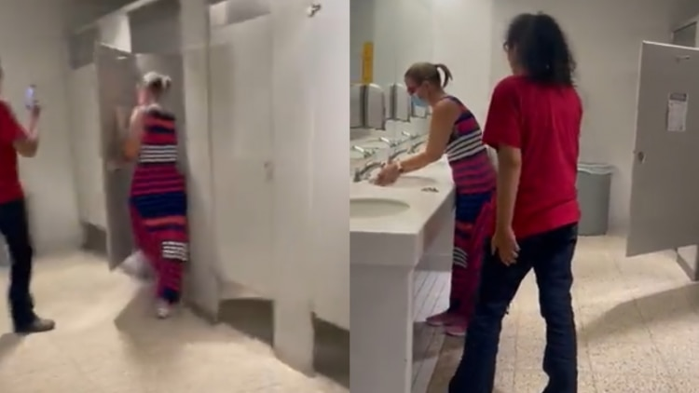
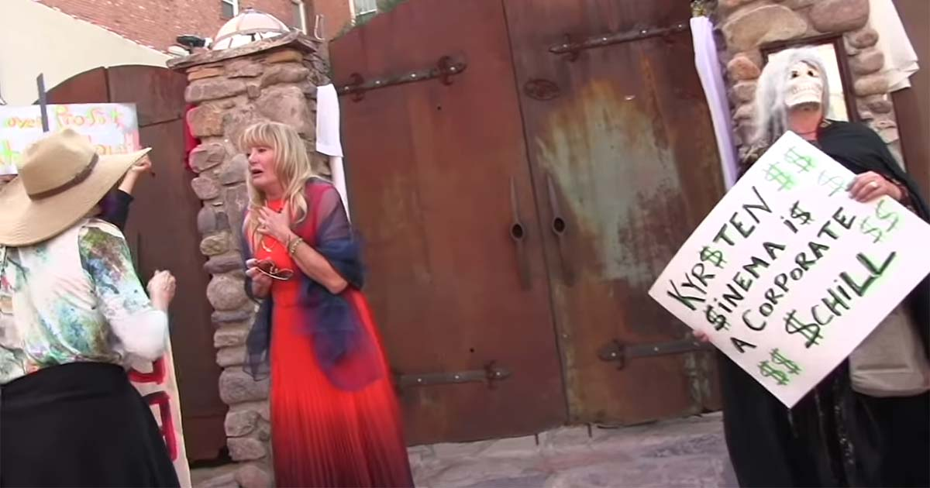
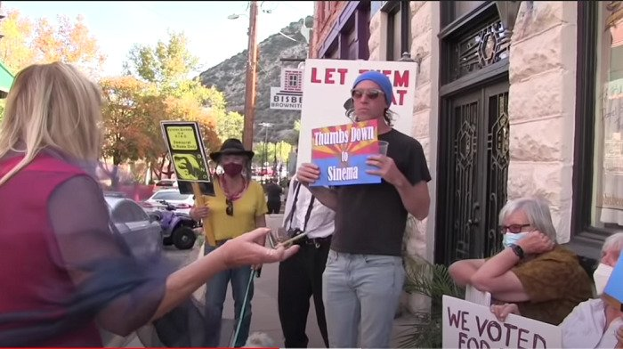
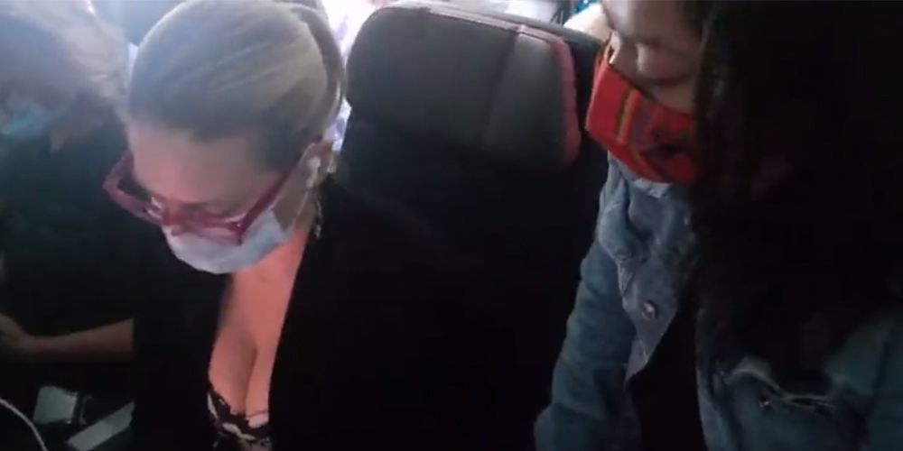
Left Paid Astroturf vs Sinema
Protesting Sinema at a Private Wedding
Stalking & Filming Sinema in the Bathroom
Protesting Sinema on a Plane

Slide 3
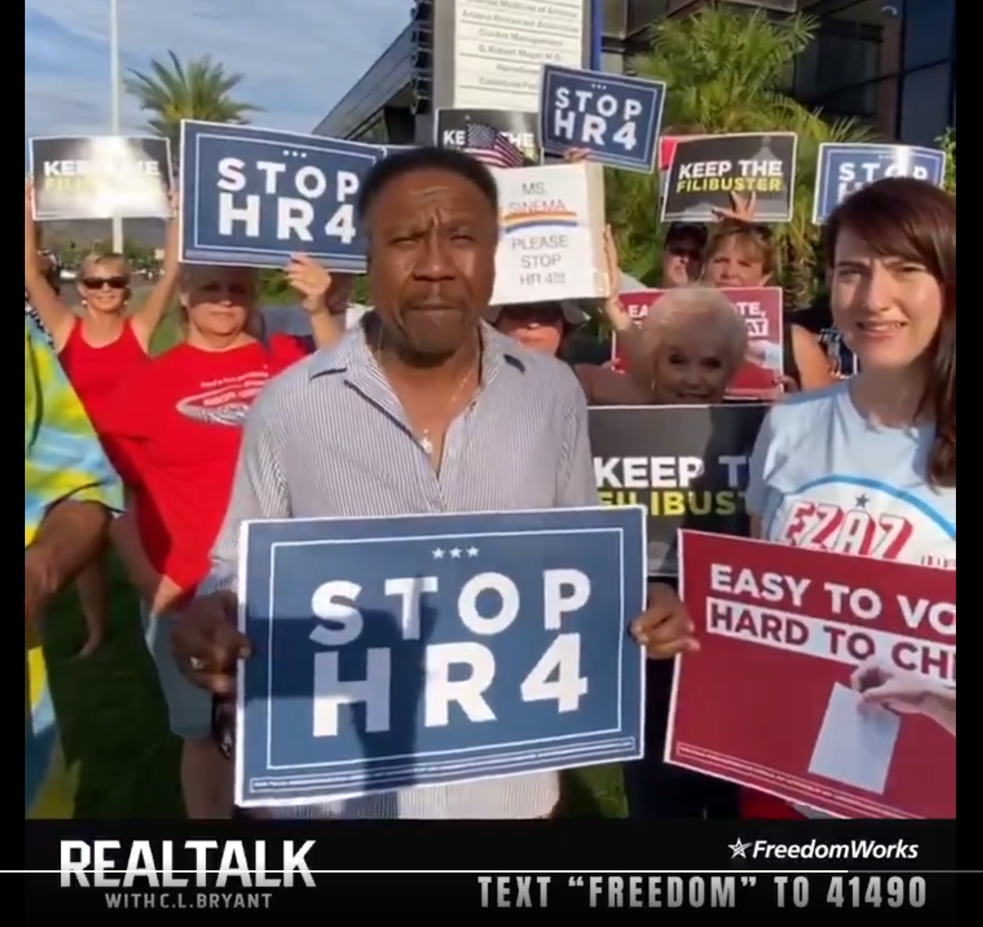
Our Grassroots vs. Sinema

Slide 4
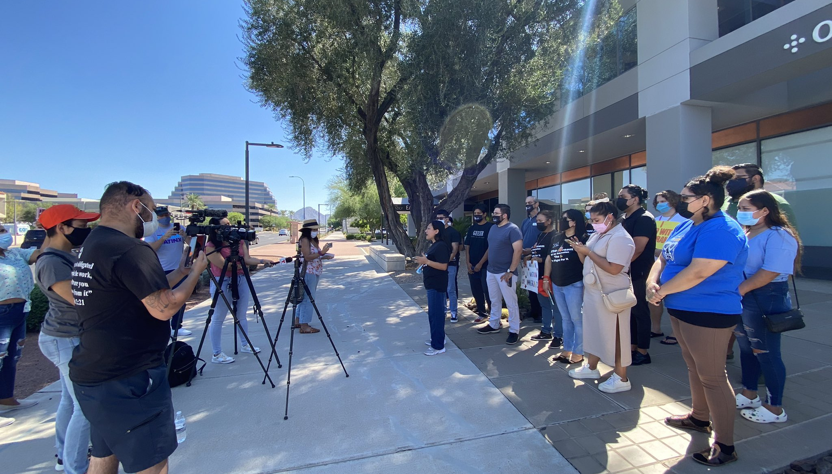
Left Paid Astroturf vs Mark Kelly

Slide 5
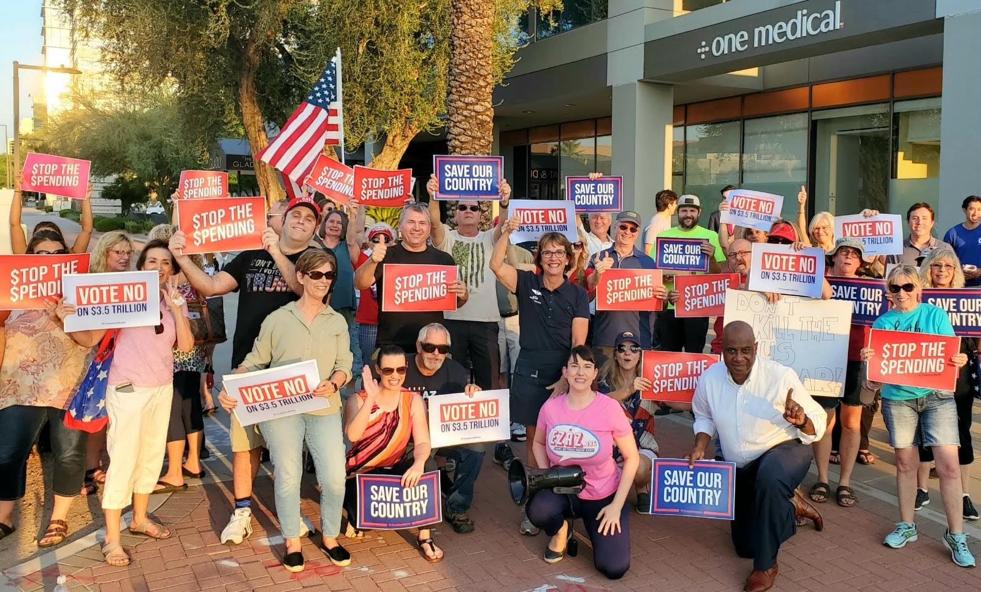
Our Grassroots vs. Mark Kelly

Slide 6
How To Effectively Use Budgets in Local & State Issues

Slide 7
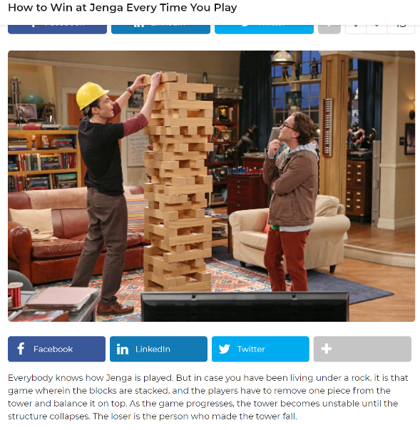



WHAT’S YOUR STRATEGY?
GRASSROOTS
POLITICIANS
BAD
GOVERNMENT
BUREAUCRATS
BAD GOVERNMENT
HOW IT STARTED
HOW IT’S GOING
GRASSROOTS
LEARN HOW YOUR BUDGETS OPERATE
BAD GOVERNMENT
FIND A WAY TO WIN!
Winner of liberty

Slide 8
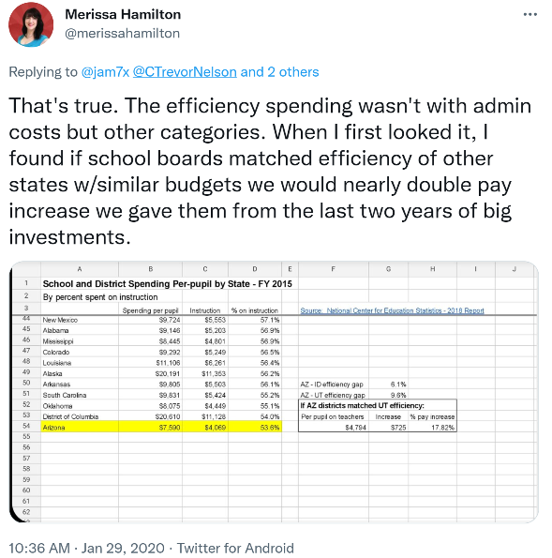
USE BUDGETS TO BEAT THE RADICAL LEFT ON POLICY
Do Not Rely on Your Government or Elected Officials to Do the Work to Find Bad Spending or Taxation.
Do the Heavy Lifting & Rally the Grassroots Around Your Wins!
In 2018, we were promised that an increase in K-12 funding would mean a 20% increase in teacher pay. Fiscal discipline with past budgets allowed for ~18% pay increase.

Slide 9
Geographic area |  | 2019 Per Pupil Total ¹ | Per Pupil Efficiency % Spending on Instruction |  |  | Growth in Spending 2019 vs 2014
 |  |  | 2019 | 2015 | Difference
United States |  | 13,187 | 60.4% | 59.9% | 0.5% | 19.9%
California |  | 14,035 | 59.7% | 59.5% | 0.2% | 46.3%
Washington |  | 14,223 | 59.7% | 57.6% | 2.1% | 39.4%
Hawaii |  | 16,132 | 58.1% | 58.8% | -0.6% | 30.1%
Oregon |  | 12,450 | 58.1% | 58.3% | -0.2% | 25.2%
Illinois |  | 16,227 | 60.1% | 61.7% | -1.6% | 24.1%
Utah |  | 8,014 | 63.2% | 63.2% | 0.1% | 23.3%
Colorado |  | 11,030 | 55.4% | 56.5% | -1.1% | 22.8%
Georgia |  | 11,228 | 60.2% | 61.8% | -1.6% | 22.0%
New York |  | 25,139 | 69.0% | 70.2% | -1.2% | 22.0%
New Hampshire |  | 17,462 | 62.5% | 63.5% | -1.0% | 21.8%
Kentucky |  | 11,291 | 58.5% | 57.5% | 1.0% | 21.2%
District of Columbia |  | 22,406 | 48.9% | 54.0% | -5.1% | 21.2%
Pennsylvania |  | 16,864 | 61.3% | 61.5% | -0.2% | 20.8%
Idaho |  | 7,985 | 59.5% | 59.7% | -0.2% | 20.6%
Connecticut |  | 21,310 | 59.4% | 63.2% | -3.8% | 20.1%
Kansas |  | 11,926 | 60.9% | 59.9% | 1.0% | 20.0%
Vermont |  | 20,315 | 58.6% | 63.3% | -4.7% | 19.6%
Ohio |  | 13,538 | 59.0% | 58.4% | 0.6% | 19.3%
Oklahoma |  | 9,323 | 56.2% | 55.1% | 1.1% | 19.1%
Massachusetts |  | 17,748 | 62.4% | 63.8% | -1.4% | 17.6%
Delaware |  | 16,315 | 61.7% | 61.8% | -0.1% | 17.1%
Minnesota |  | 13,387 | 64.9% | 64.8% | 0.1% | 16.8%
North Carolina |  | 9,857 | 63.0% | 62.2% | 0.7% | 15.8%
Geographic area |  | 2019 Per Pupil Total ¹ | Per Pupil Efficiency % Spending on Instruction |  |  | Growth in Spending 2019 vs 2014
 |  |  | 2019 | 2015 | Difference
United States |  | 13,187 | 60.4% | 59.9% | 0.5% | 19.9%
Virginia |  | 12,641 | 60.7% | 60.9% | -0.2% | 15.2%
Maine |  | 14,614 | 56.4% | 58.8% | -2.3% | 15.0%
Michigan |  | 12,756 | 57.7% | 57.5% | 0.2% | 14.8%
New Jersey |  | 20,512 | 57.7% | 59.3% | -1.6% | 14.6%
Arizona |  | 8,625 | 54.6% | 53.6% | 0.9% | 14.6%
South Carolina |  | 11,140 | 54.5% | 55.2% | -0.6% | 14.5%
Texas |  | 9,827 | 59.1% | 57.8% | 1.2% | 14.4%
Tennessee |  | 9,868 | 60.6% | 61.4% | -0.7% | 14.3%
South Dakota |  | 10,139 | 59.3% | 58.5% | 0.8% | 14.2%
Rhode Island |  | 16,750 | 57.8% | 61.4% | -3.5% | 13.4%
Missouri |  | 11,200 | 56.5% | 59.0% | -2.5% | 13.4%
North Dakota |  | 14,004 | 60.2% | 59.4% | 0.8% | 13.3%
New Mexico |  | 10,177 | 56.5% | 57.1% | -0.6% | 13.0%
Wisconsin |  | 12,598 | 58.7% | 59.5% | -0.7% | 12.6%
Mississippi |  | 9,284 | 56.6% | 56.9% | -0.2% | 12.4%
Alabama |  | 10,077 | 56.7% | 56.9% | -0.2% | 11.6%
Iowa |  | 11,907 | 60.0% | 60.9% | -0.9% | 11.6%
Nevada |  | 9,344 | 58.1% | 58.1% | 0.0% | 11.1%
Florida |  | 9,645 | 61.2% | 61.4% | -0.2% | 10.2%
Louisiana |  | 11,755 | 55.8% | 56.4% | -0.6% | 9.4%
Indiana |  | 10,397 | 57.4% | 57.5% | -0.2% | 8.9%
Montana |  | 11,988 | 59.0% | 58.8% | 0.2% | 8.8%
Nebraska |  | 12,743 | 62.1% | 63.9% | -1.8% | 8.7%
Maryland |  | 15,148 | 62.6% | 62.5% | 0.2% | 8.2%
Arkansas |  | 10,388 | 56.2% | 56.1% | 0.1% | 8.0%
West Virginia |  | 12,010 | 57.6% | 57.2% | 0.4% | 6.7%
Wyoming |  | 16,304 | 59.5% | 59.5% | -0.1% | 3.2%
Alaska |  | 18,394 | 53.2% | 56.2% | -3.0% | -0.1%
School Boards:
Per Pupil Spending Increased 20% in 2019 vs 2014

Slide 10
How much spending is fully funded K-12?
Where Did the Money Go?
MESSAGING

Slide 11
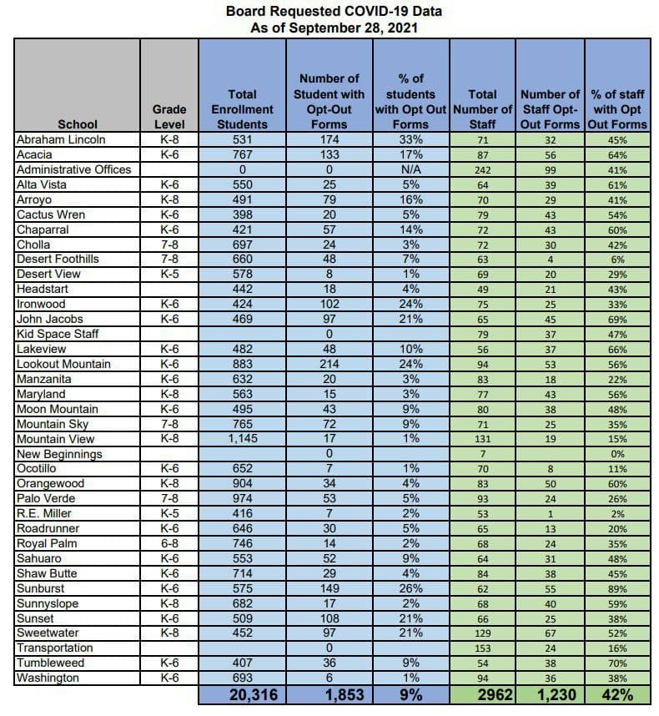
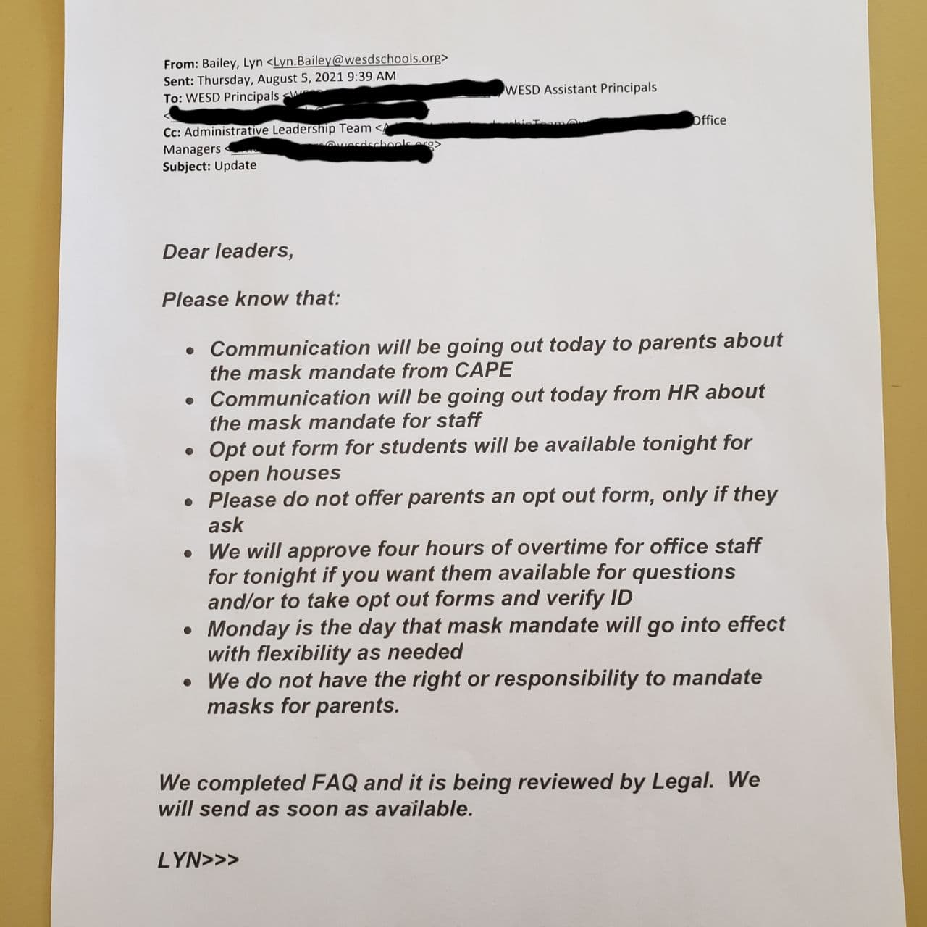

Slide 12
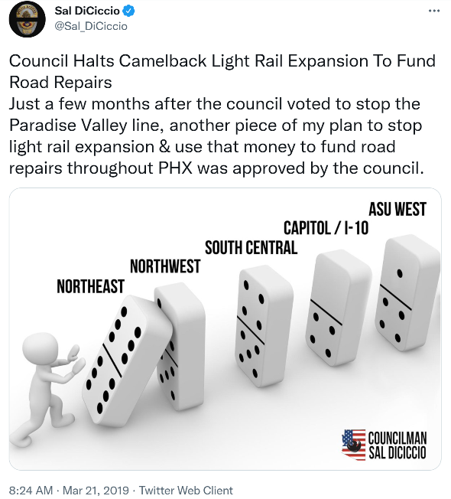
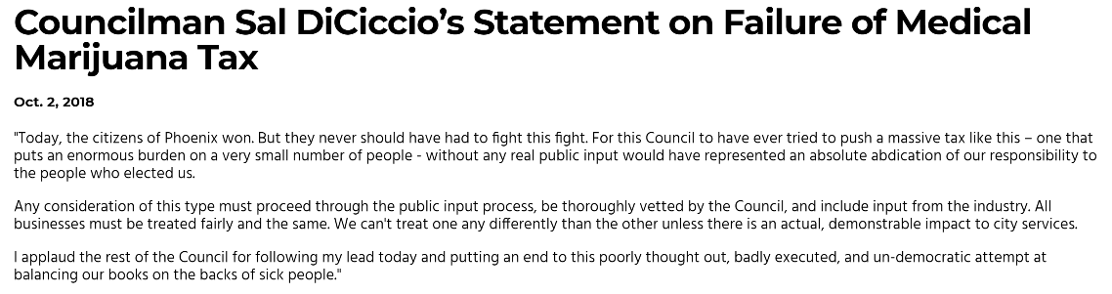
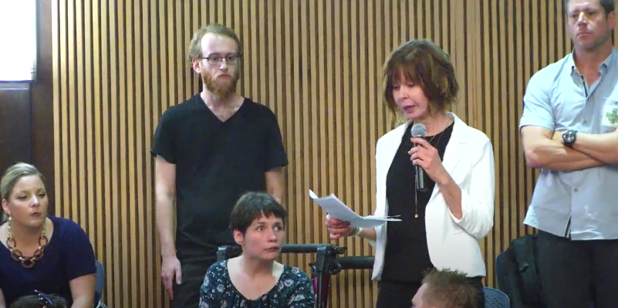
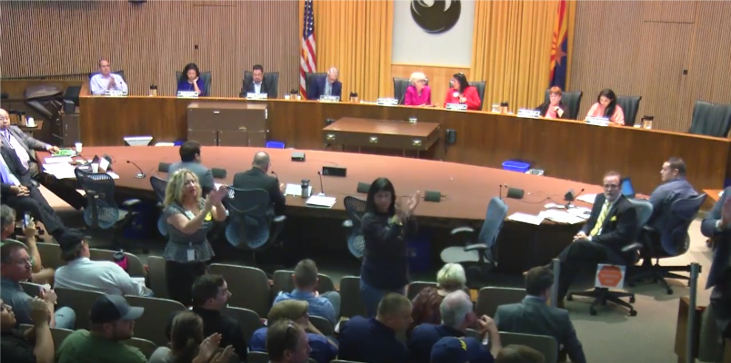
Budgets Win at the Local Level
Accomplishments:
Defeated small business tax on medical dispensaries by rallying 300 community leaders at City Council meeting saving the industry
redirected $500M funding into crumbling infrastructure without a tax increase
discovered city bureaucrats hid light rail lines were over budget by 39%
passed historic vote to leave the League of Cities and Towns saving tax payers $145k/yr.

Slide 13
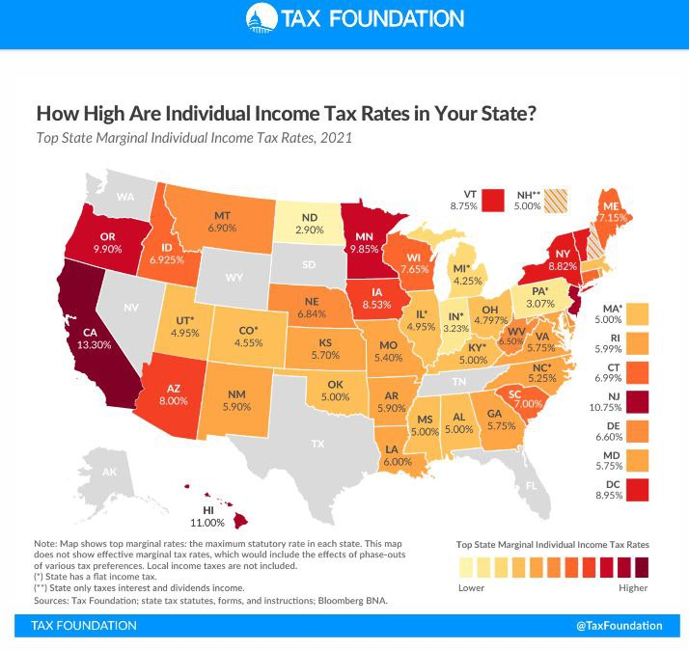
Don’t Let Government Steal Your Pie!
How to Use Budgets at the State Level
The 2021 Session Ended with a Flat tax of 2.5%/3.5% passed with a cap at 4.5%

Slide 14
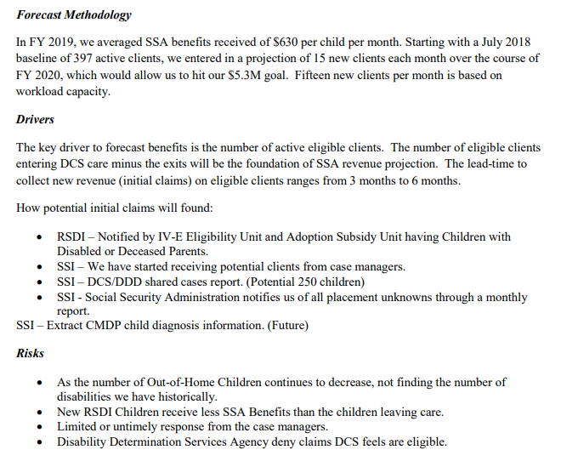
Arizona DCS (Child Protective Services) Budget
Director lists the number of Out of Home children and children with disabilities decreasing as a risk for their budget forecast
Why are they relying on taking children with disabilities from their families to plan their budget?
Resulted in a meeting with the Director of DCS and additional legislation to protect parental rights.
SOURCE: DCS Budget Page 16 https://dcs.az.gov/sites/default/files/DCS-Reports/FY2021-DCS%20Budget%20Submittal.pdf

Slide 15
How to Keep Up the Momentum

Slide 16

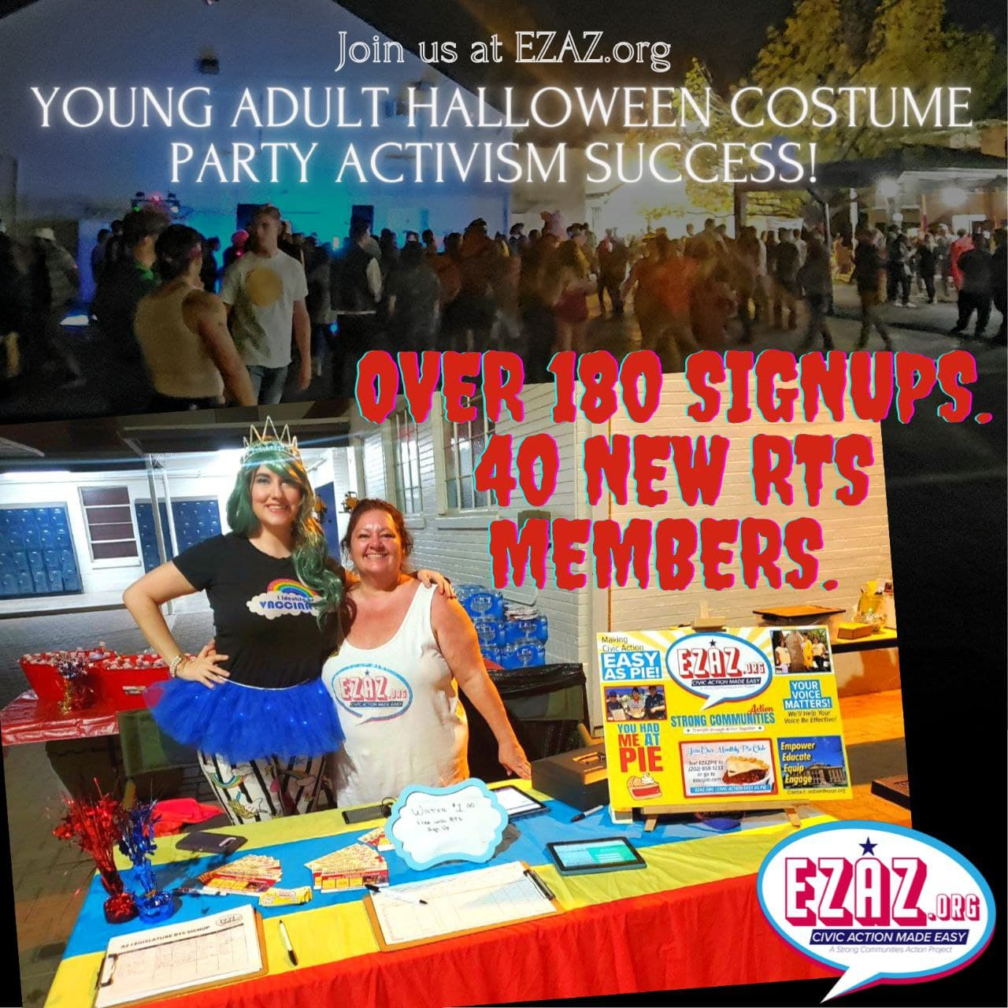
Be Creative
Get Started & Recruit – Low Barrier Activism
Educate – Do the Heavy Lifting to Make it Easy
Act – Be Strategic, Effective & Pragmatic when necessary.
  Don’t waste your volunteers’ or legislators’ time!
  Find allied groups & stay united.
  Don’t duplicate or compete in your efforts. Find your lane.
Stay unified with allied legislators
              (And be the wedge against uncooperative legislators)
Weekly Action Alerts
  (Top 3-5 issues)
Make Public Comment Great Again
Monthly Education – Make it Fun (Pie Club)
Recruit – Recruit - Recruit

Slide 17
How Can the Grassroots Restrain the Federal Government?
Be Creative

Slide 18
Restrain the Power of the Federal Government Over States
Make Our States Great Again
What if your State became the tax collector for the income tax and distributed funds to the Federal Government?
Shrink the IRS & Give the Leverage Back to the States

Slide 19
“Create the movement.”
“Be you.”
Be the Grassroots where Our Government is of the People, by the People, for the People.
Let’s Win!
“Don’t be shy to stand by your convictions.”
“Attend every possible event you can go to.”
“Don’t back down.”

Slide 20
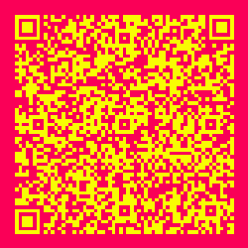
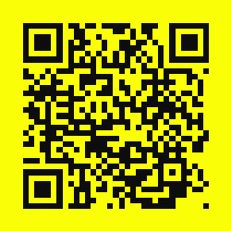
THANK YOU! action@ezaz.org
Contact Merissa:
Don’t Let Government Steal Your Pie!
merissa@merissahamilton.com 480-374-0102
MerissaHamilton.com

